Slide 1
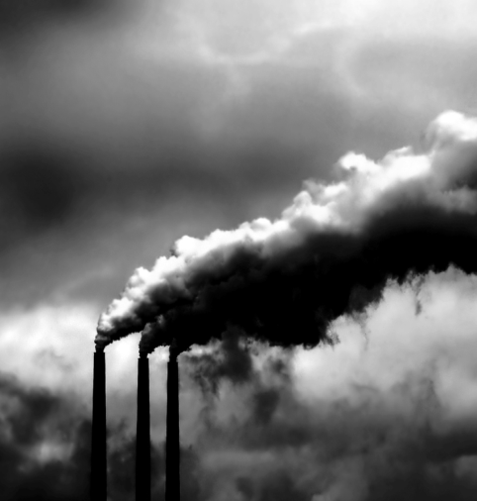
Targeting the causes of biodiversity loss:
Greenhouse gas regulations

Slide 2
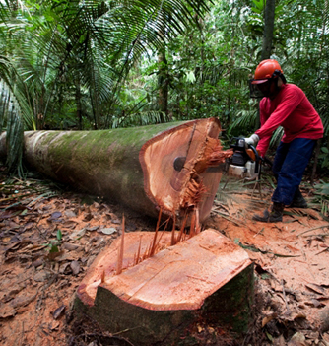
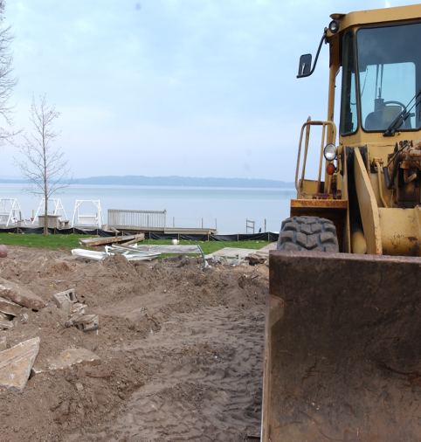
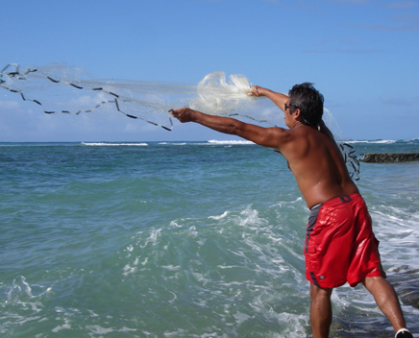
Targeting the causes of biodiversity loss: climate change
Education
Corruption
Individuals level (DavidSusuki.org)
Get informed and involved
Fly less
Take public transport (walk, bike, car pool)
Take care of your trash
Create an energy efficient home
Use electricity from sustainable energies
Get your home an energy audit
Eat wisely (local foods avoid transport)
Buy energy efficient cars (if you buy one)
Use recycled/reused materials
Government level (IPCC 2007 report)
Carbon tax
Tradable carbon permits
Inequity
Wealth
To many humans
Human needs
Household
Food
Energy
Protected areas, Regulation policies
Deforestation
Habitat modification
Over-harvesting
CO2 emissions

Slide 3
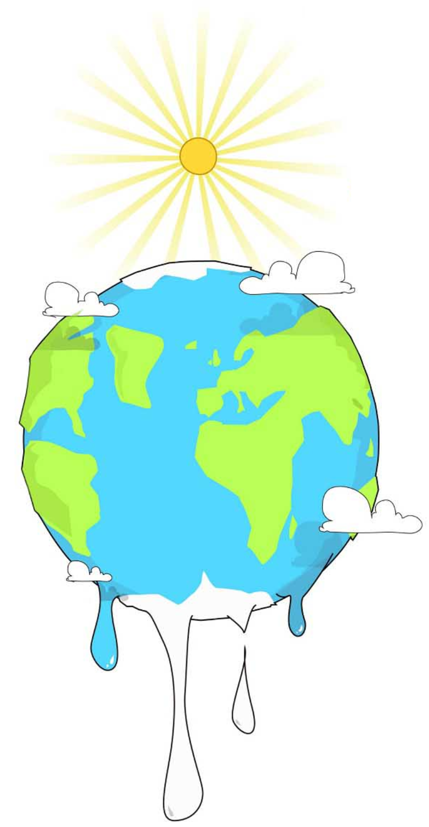
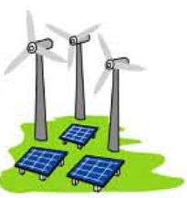

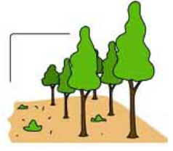
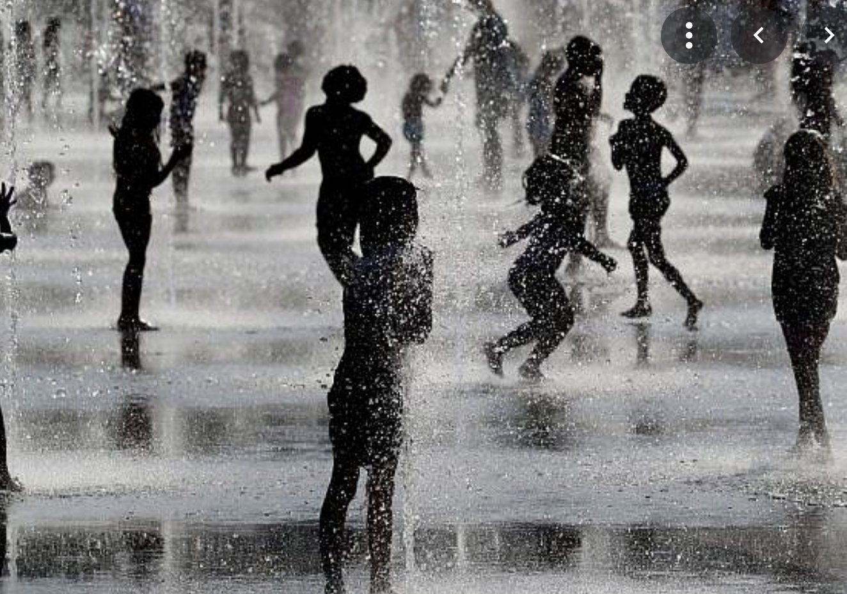
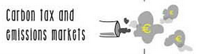
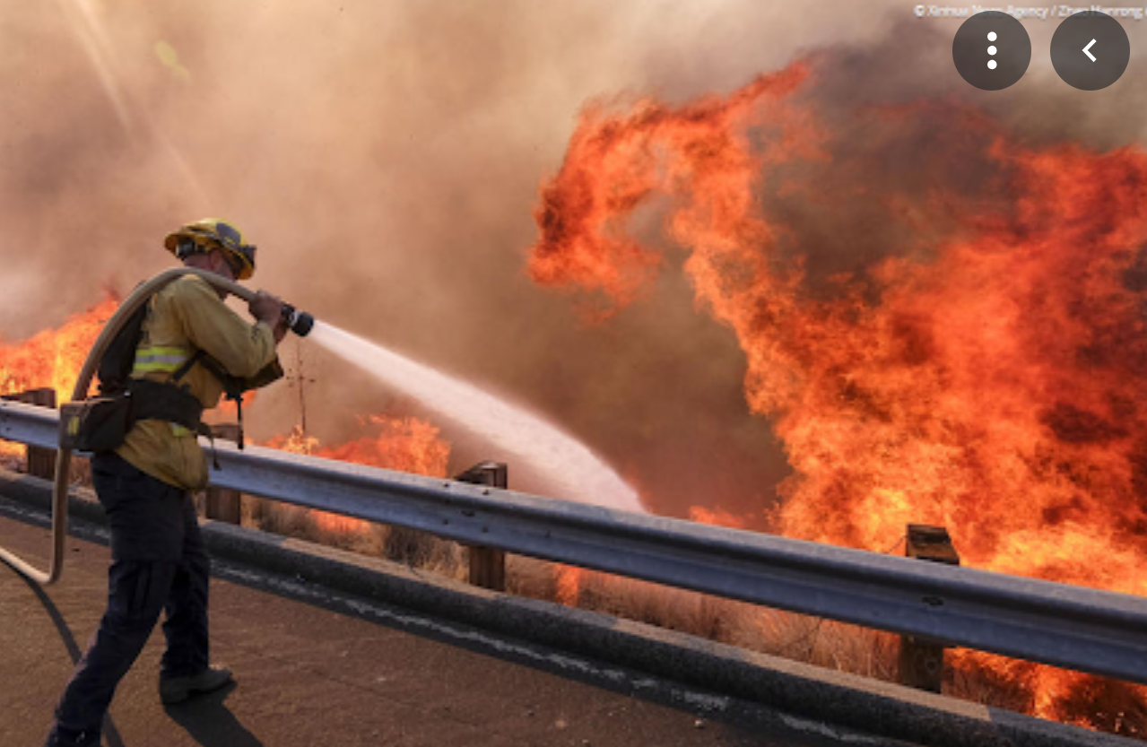
Solutions to climate change
Mitigation attempt to the causes of climate change, adaptation addresses its impacts
Mitigation
Adaptation
Notes:
Lets imagane for a second that I am friend with Myke Tyson, and he keeps bulling me punching me in the face all the time. That is obviolsy a problem that I can adapt to by buy face protection gear, so that evrythime he ponches, I do not feel the pain. A mitigation solution will be for him to stop ponching me.

Slide 4
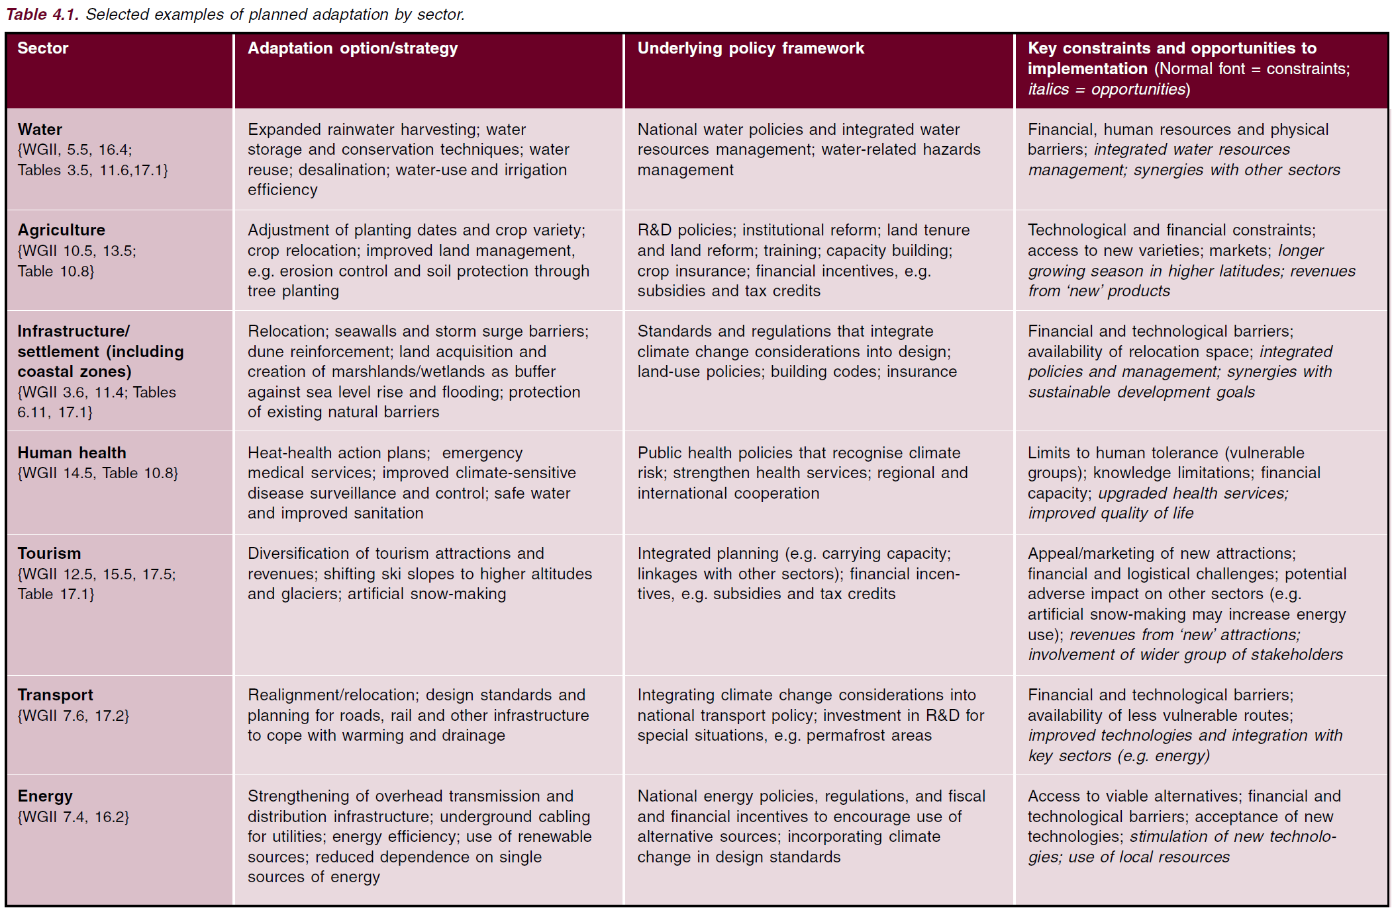
Adaptation solutions to warming proposed by the IPCC

Slide 5
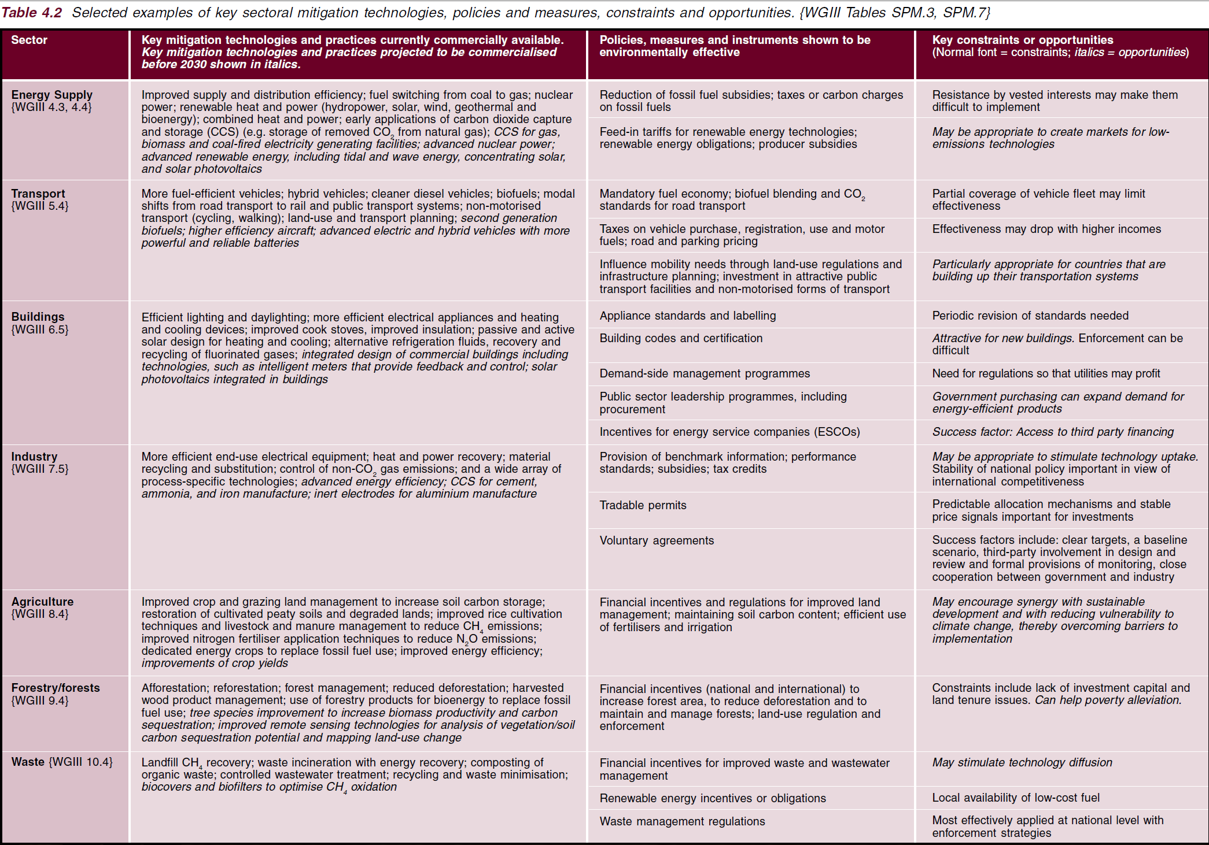
Mitigation solutions to warming proposed by the IPCC

Slide 6

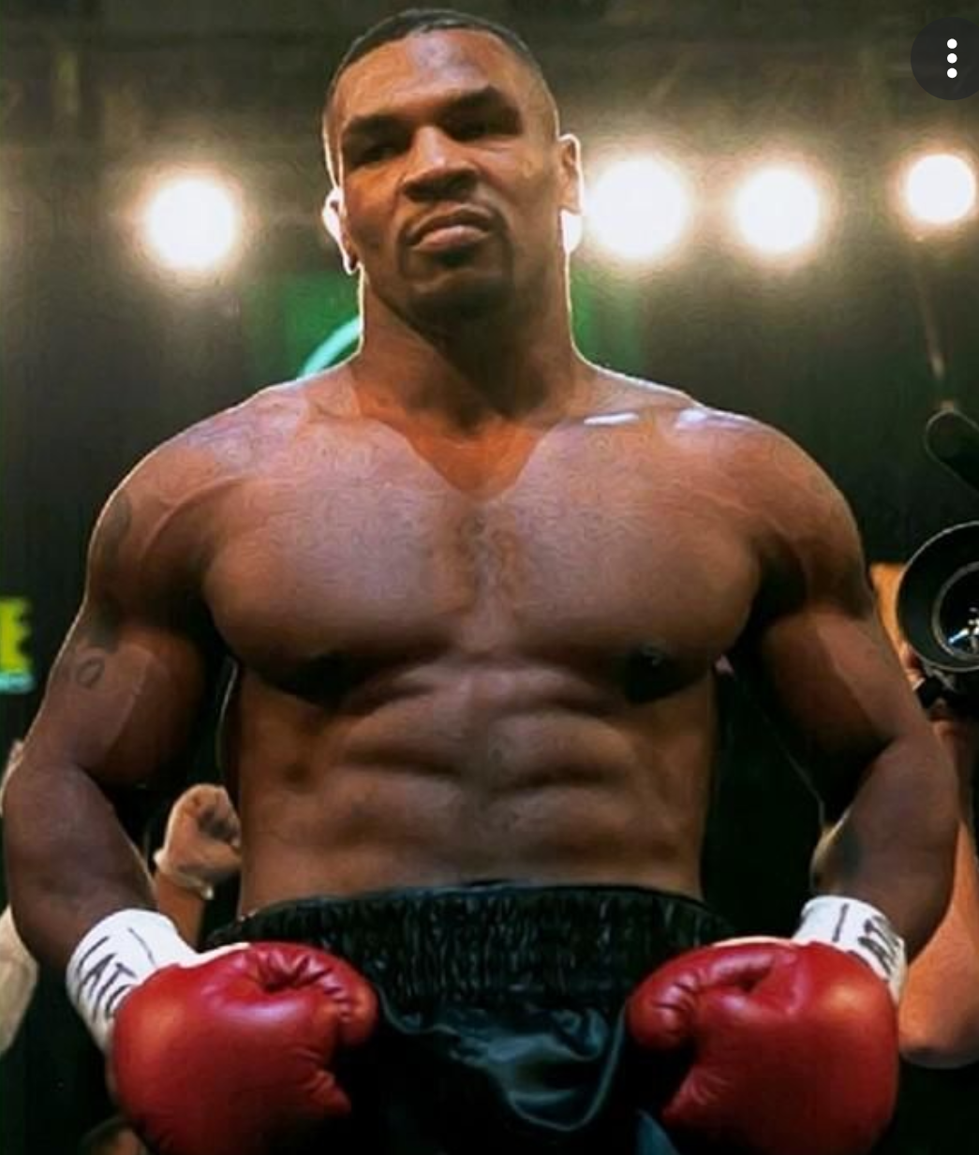
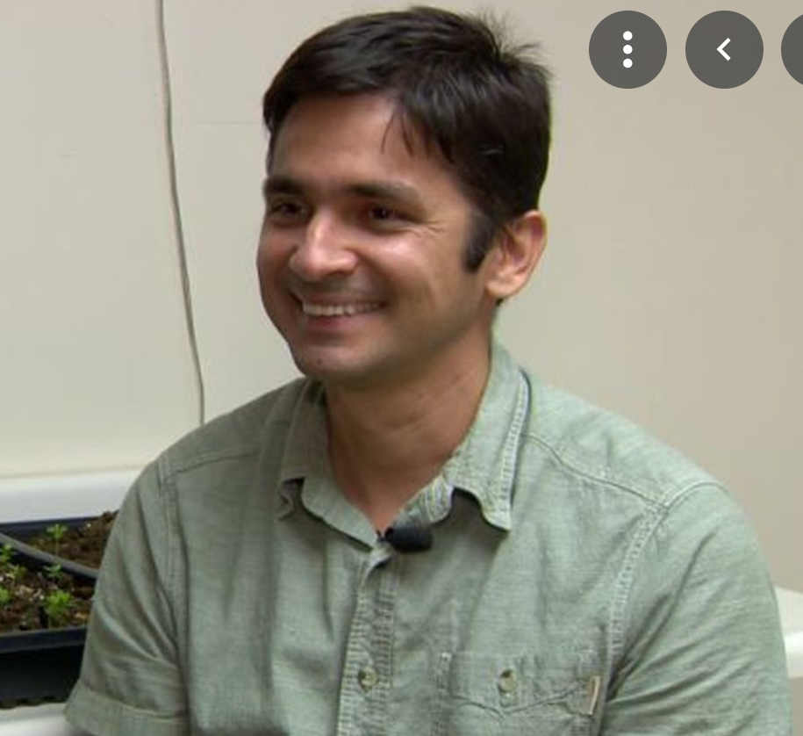

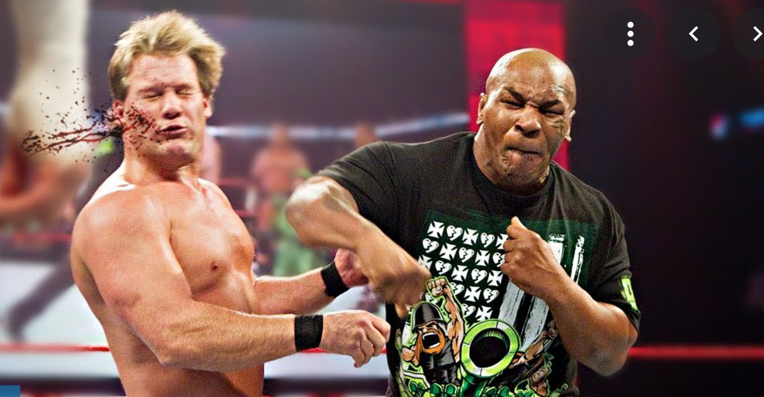

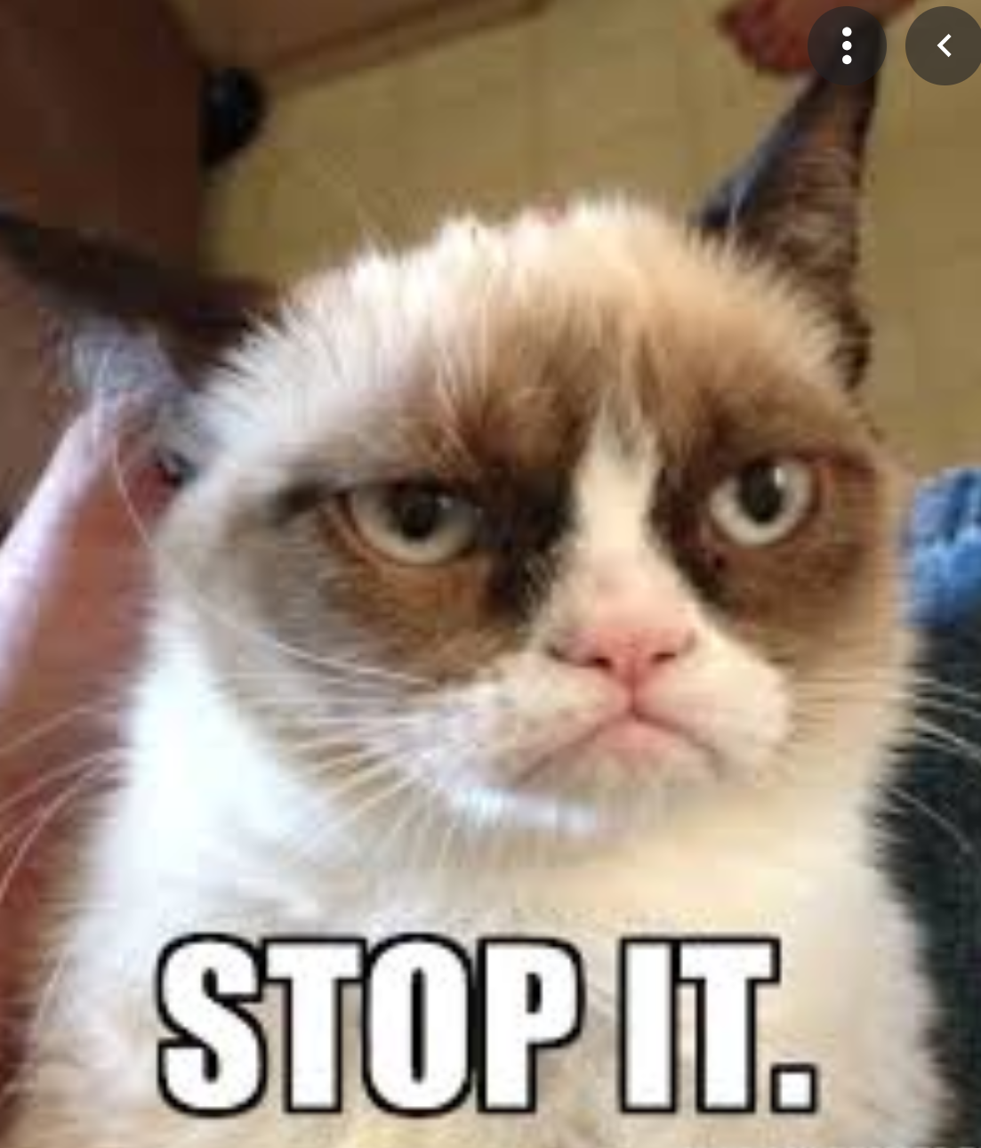
Mitigation
or
Adaptation
Adaptation
The problem
Mitigation

Slide 7
How to encourage carbon emissions controls
Integrating climate policies in broader development policies
Regulations and standards
Taxes and charges
Tradable permits
Financial incentives
Voluntary agreements
Information instruments
Research, development and demonstration
Part of the Kyoto protocol
IPCC 2007 report

Slide 8
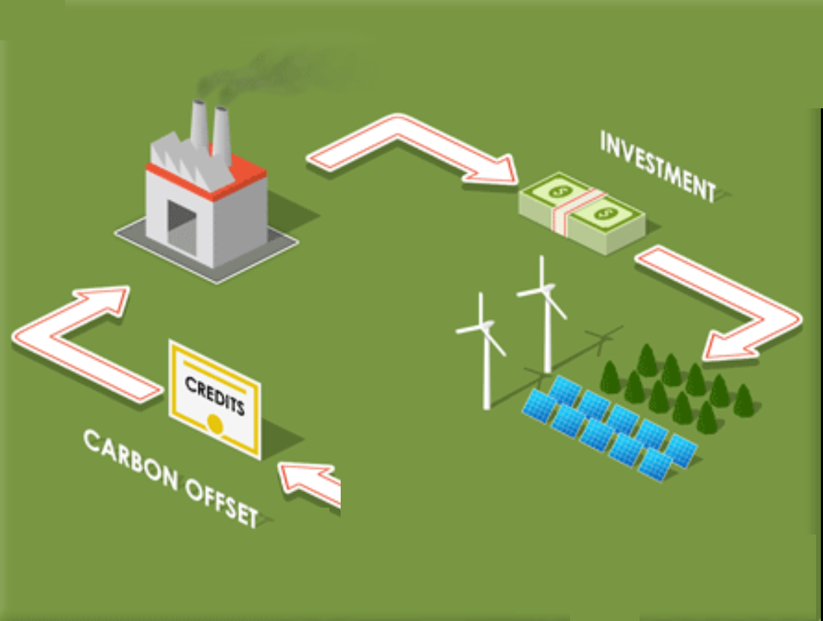

Tradeable carbon credits
Government

Slide 9
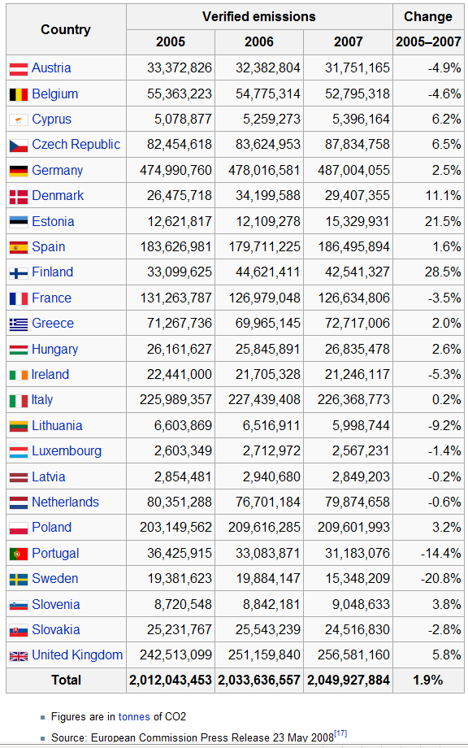
Does it work?
European Union Emission Trading Scheme
Allowances were higher than companies actually use
No need for trade
Despite potential benefits, global international trading markets are restricted:
European Union Emission Trading Scheme
Chicago Climate Exchange (voluntary)

Slide 10
Problems
Voluntary
Unfair
competition
Tradeable carbon credits
Develop countries mainly (only)

Slide 11
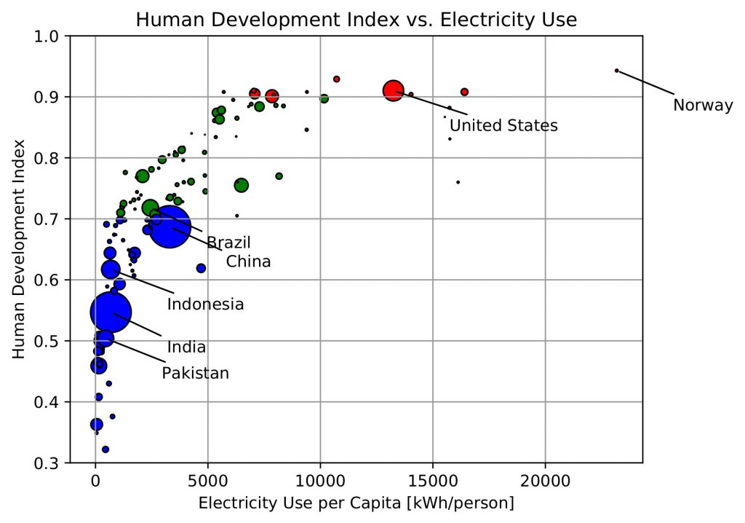
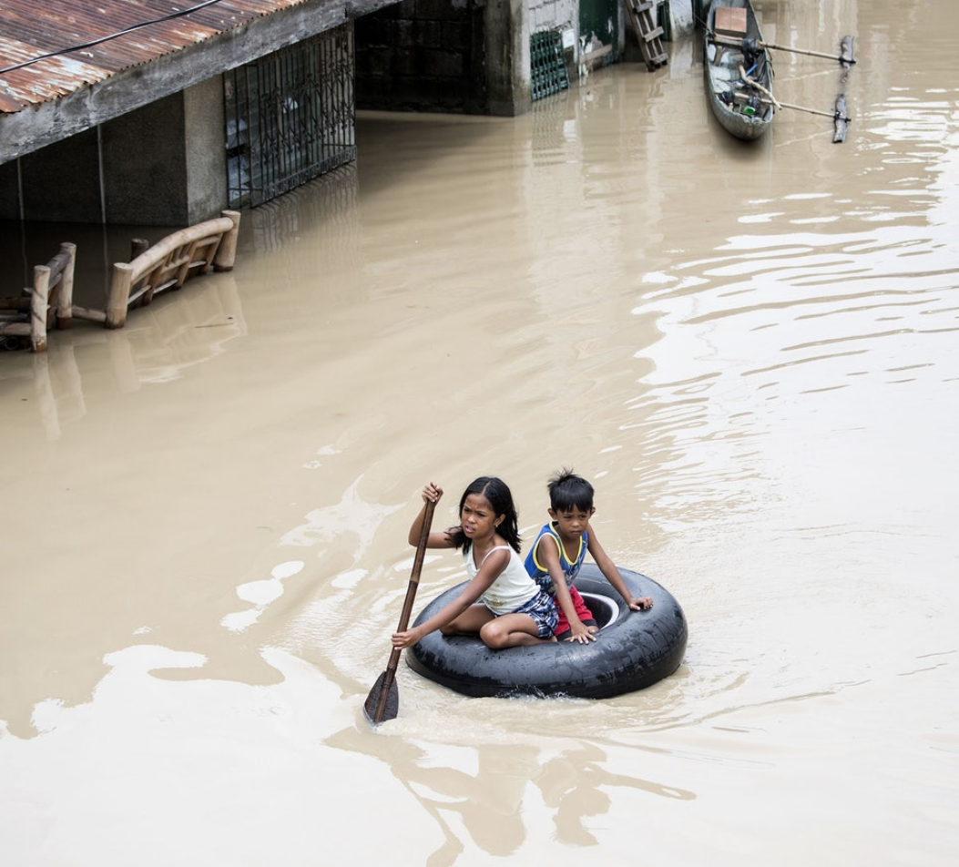
Green climate fund
Less than $10 billion given
Burden
$US100billion

Slide 12
Can we fix climate change?
Identifying the bottleneck to success

Slide 13
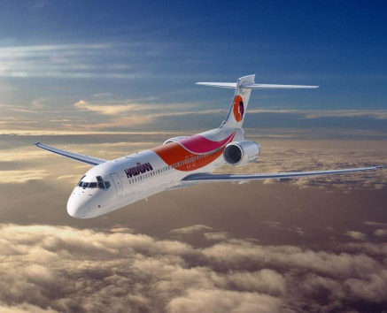

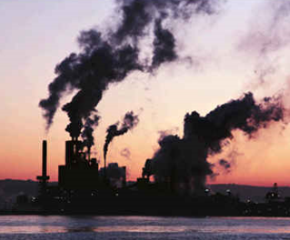
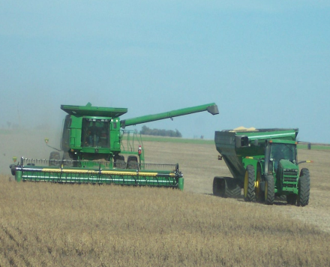
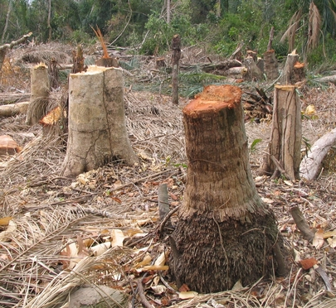
How do we succeed?
Success of individual and governmental solutions to climate change
..cause climate change…
…and affect biodiversity and human wellbeing.
Public acceptance

Slide 14
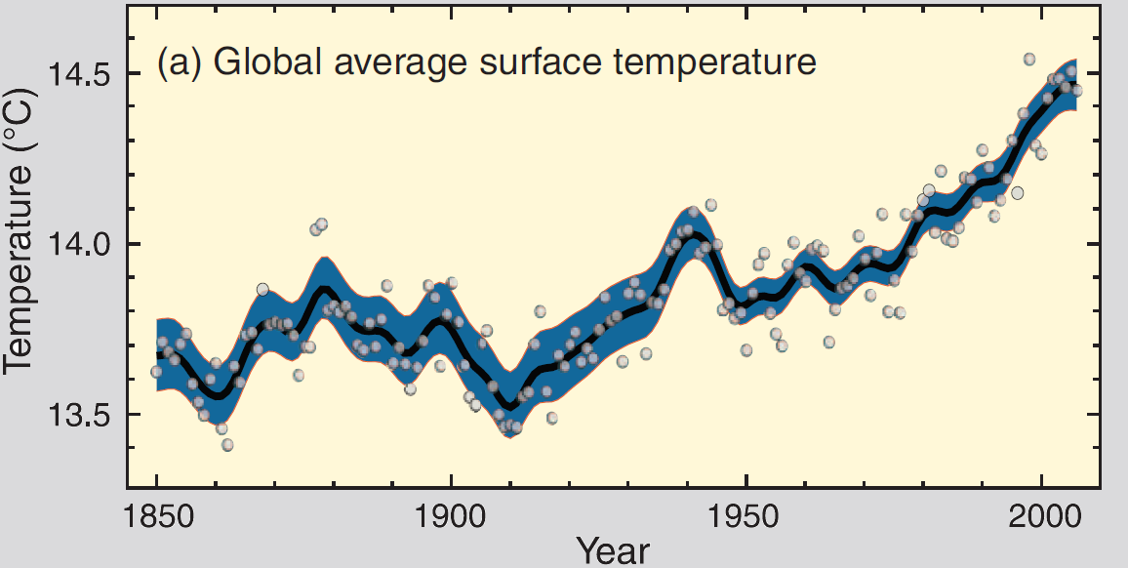
Solutions require us to accept that the climate is warming…
IPCC 2007 report

Slide 15
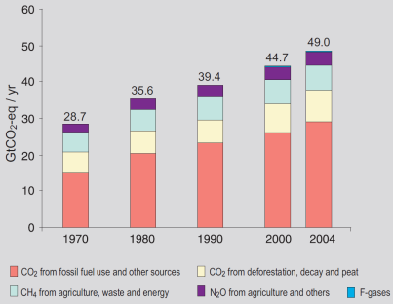
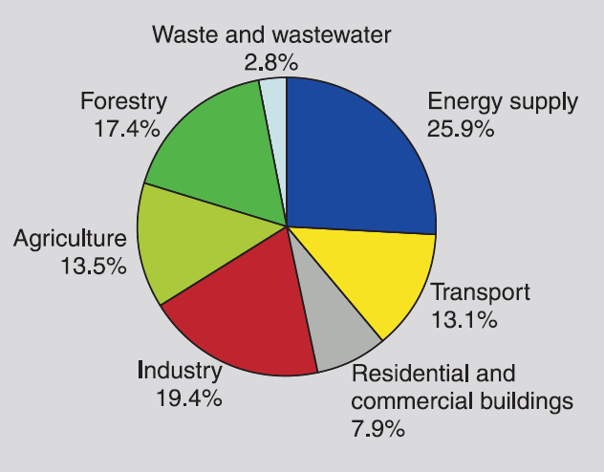
…and that are humans responsible for such a warming…
IPCC 2007 report

Slide 16
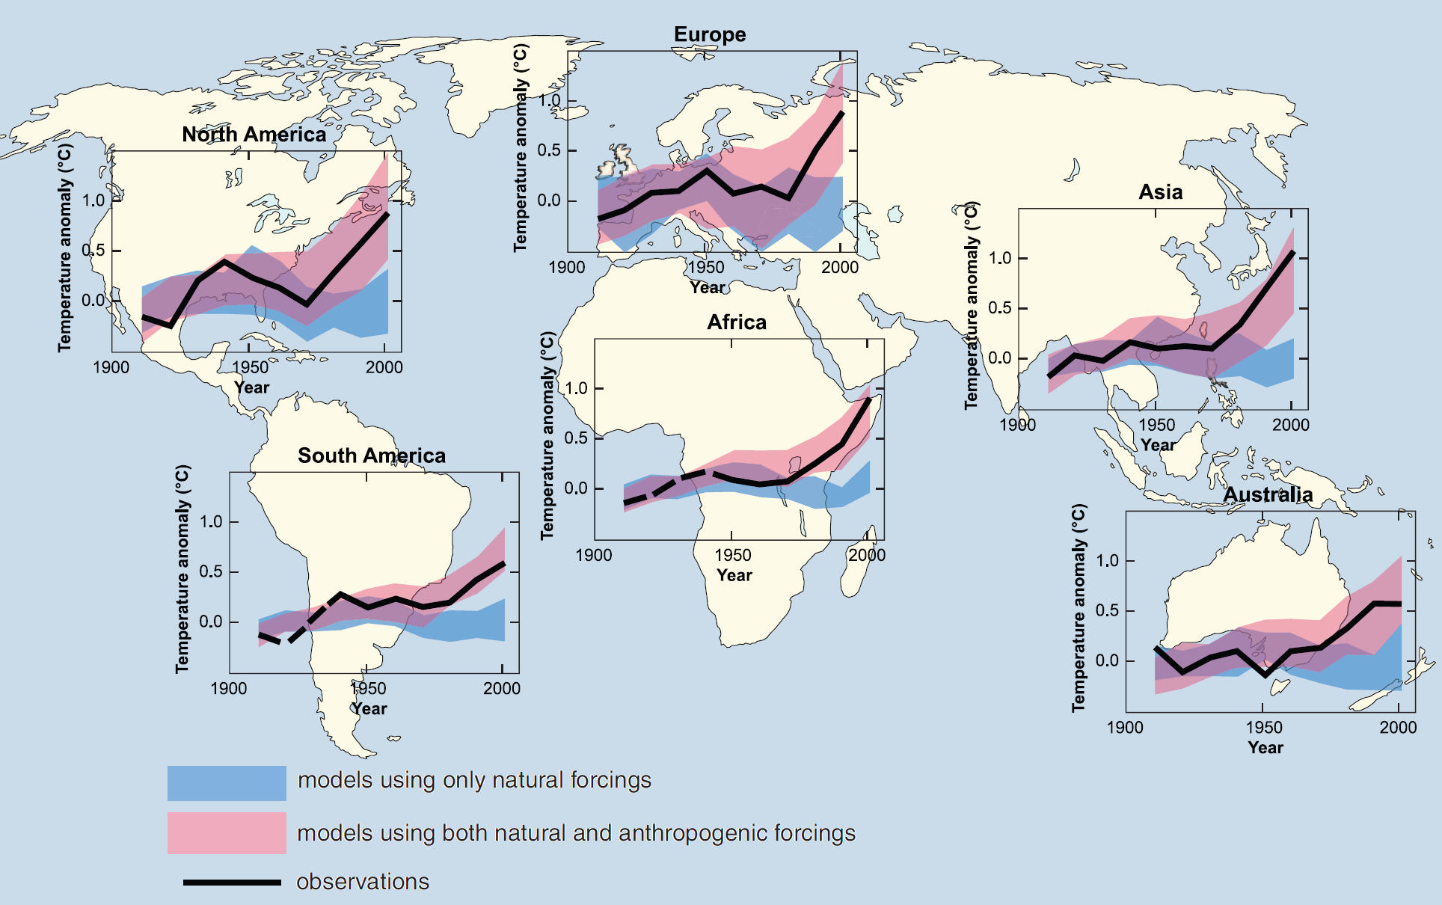
…models confirm the role of anthropogenic forces on climate warming…

Slide 17
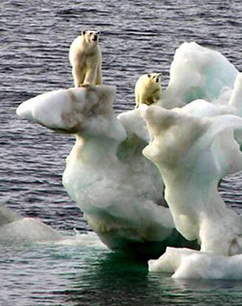
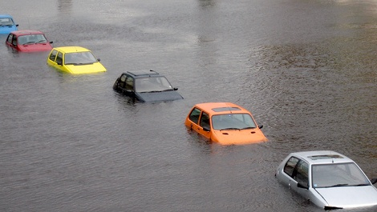
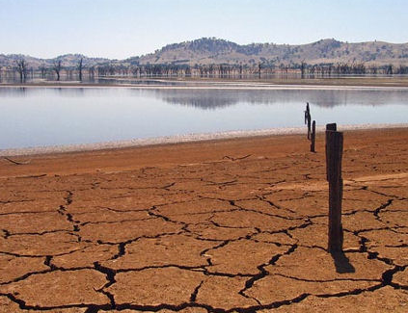
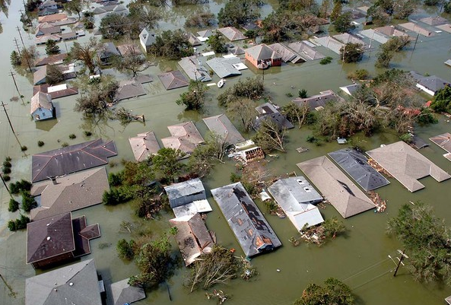
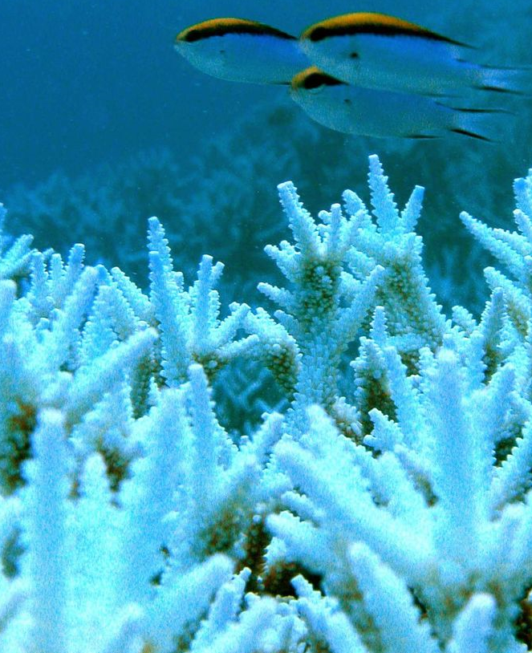
…and finally, that biodiversity and human wellbeing will be affected.

Slide 18
Success of individual and governmental solutions to climate change
..cause climate change…
…and affect biodiversity and human wellbeing.
Public acceptance
Scientific knowledge
Public understanding

Slide 19
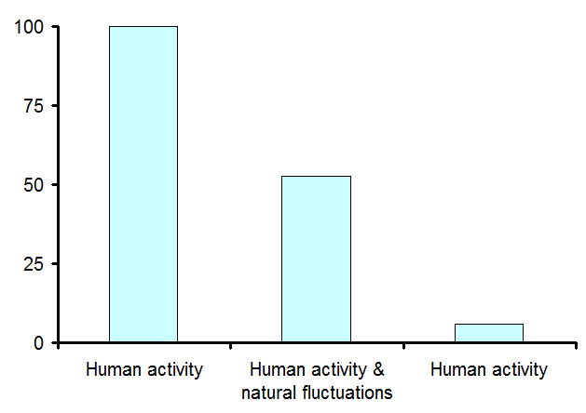
Scientific knowledge
Public understanding
Reduce public acceptance
Uncertainty
Media
“fairness” introduces “false balance”
quoting outliers among a tiny minority of scientists elevates their minority view to a status it does not deserve
Scientific peer-review articles (source 1)
100% of 928 articles
News articles (source 2)
Percentage of articles attributing warming to
52.7% of 636 articles
6% of 636 articles
Sources:
1. Oreskes, Nature reports, 2004
2. Boykoff & Boykoff, Global Environmental Change 2004

Slide 20
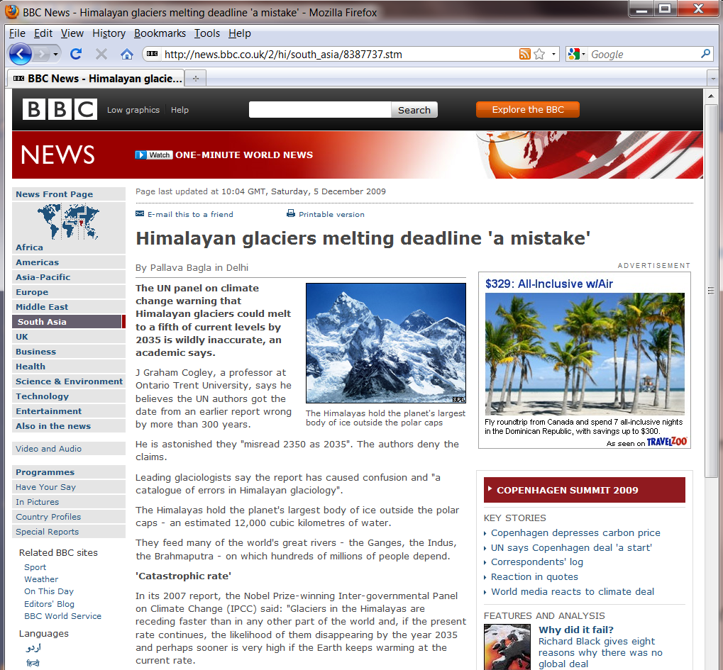
Scientific knowledge
Public understanding
Reduce public acceptance
Uncertainty
Media
“fairness” introduces “false balance”
“Alarmists”
Honest
Errors

Slide 21
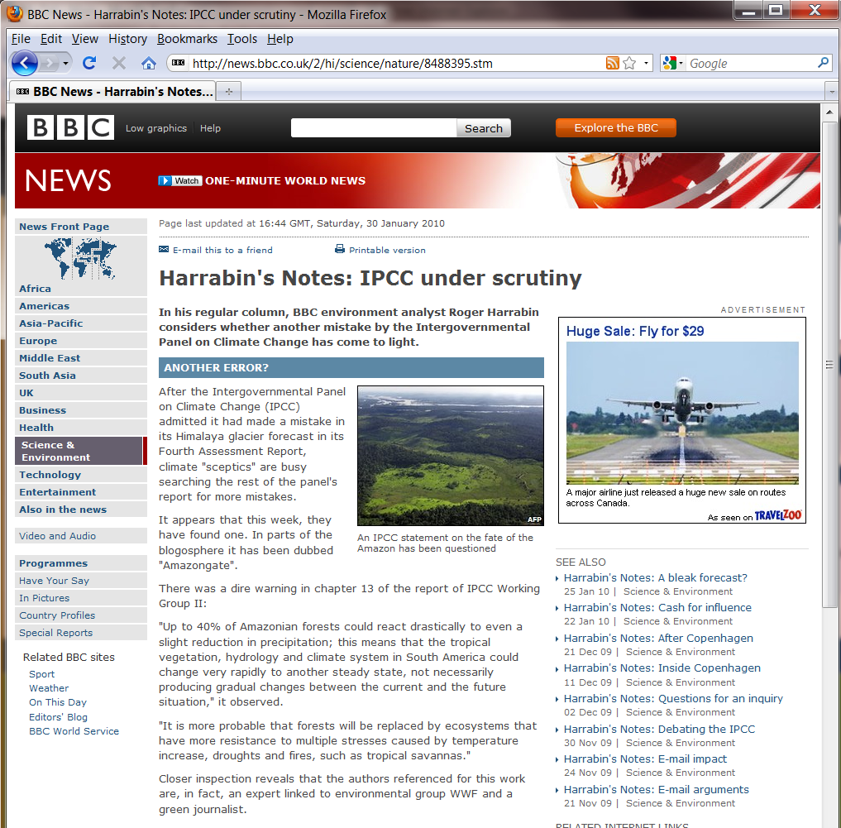
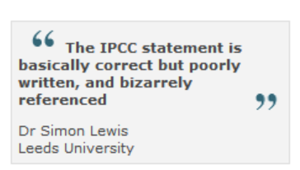
Scientific knowledge
Public understanding
Reduce public acceptance
Uncertainty
Media
“fairness” introduces “false balance”
“Alarmists”
Honest
Errors
“False”
From BBC Online
Notes:
The accusation here is that The IPCC also made false predictions on the Amazon rainforests by referencing to a non-peer reviewed paper produced by an advocacy group working with the WWF. A blunder perhaps, but maybe of a different kind, because there is indeed plenty of published science warning about drought in the Amazon.
Authors of some of that research are not happy that the IPCC chose to reference WWF rather than the basic science itself.

Slide 22
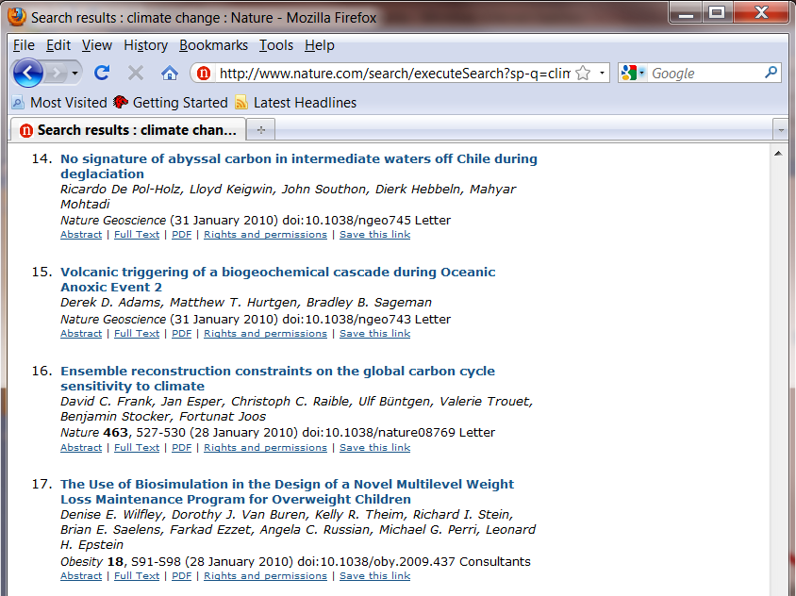
Scientific knowledge
Public understanding
Reduce public acceptance
Uncertainty
Media
“fairness” introduces “false balance”
“Alarmists”
Search in Nature journal using key words:
“Climate change”
Honest
Errors
“Untruth”
Scientific complexity
Lack of media and public interests

Slide 23
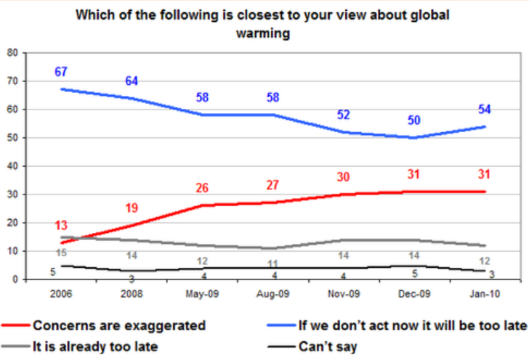
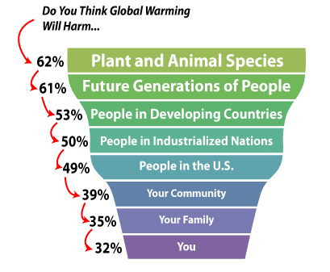
Public perception on climate change
US population
George Mason University’s Center for Climate Change Communication (2009)
The tragedy of reduce public attention
Low relevance
Reduced interest for actions
Increasing skepticism

Slide 24
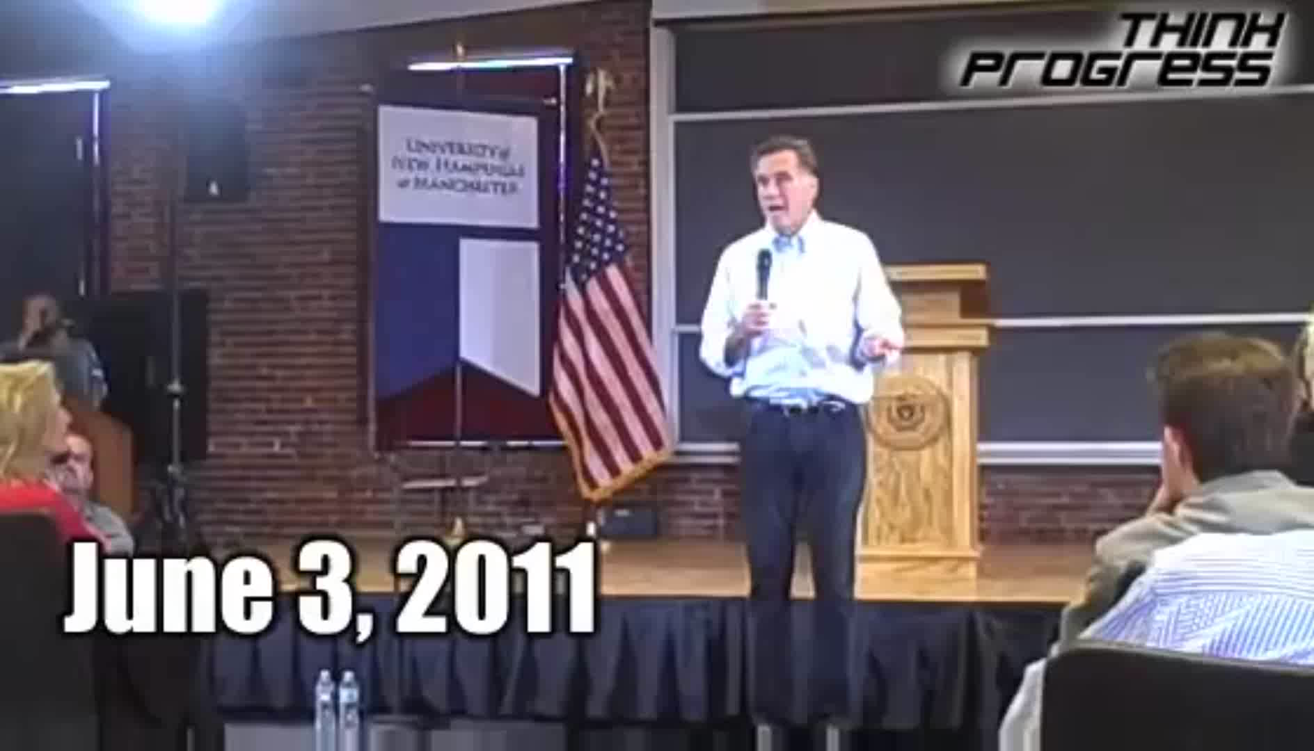
Ignorance at public level, capitalized by political purposes?...
Why the change in opinion?
Because there will be no political harm
Funding benefits

Slide 25
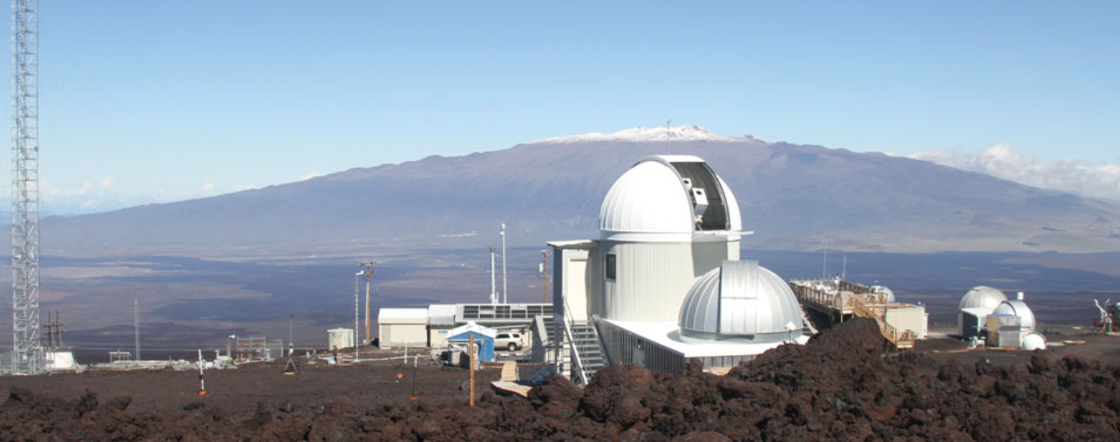
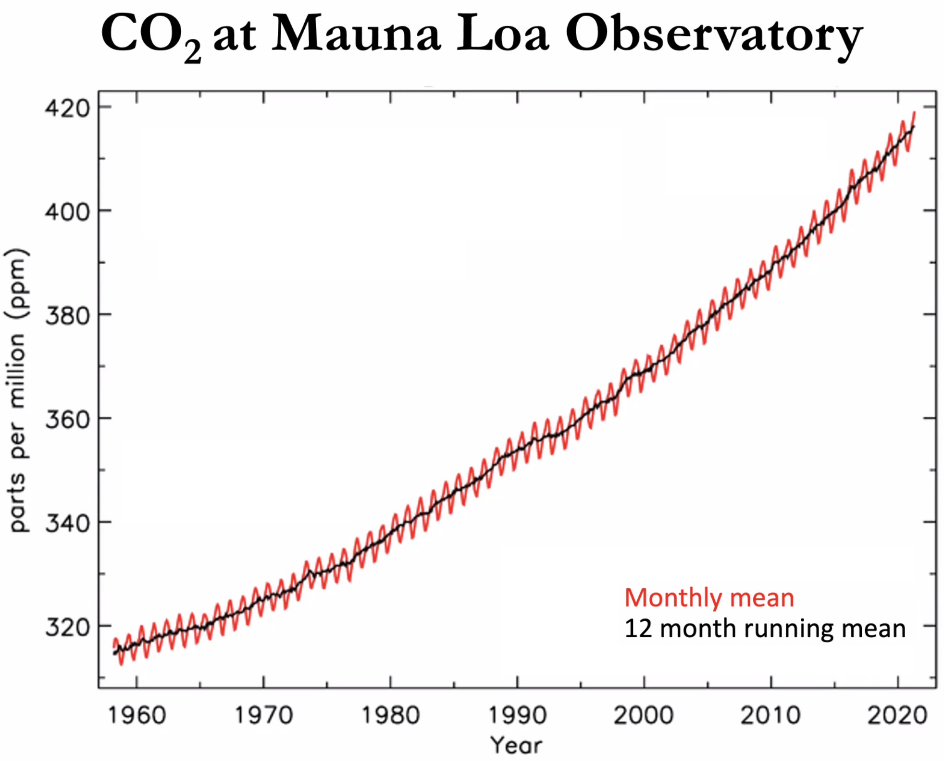
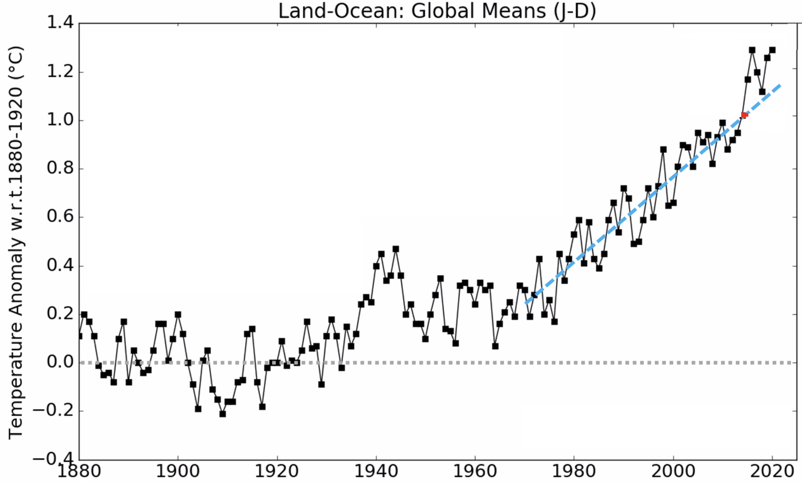
Are solutions working?: the ultimate test
~2.4ppm/yr→
The planet keep getting hotter
CO2 keeps going up
←~0.82ppm/yr

Slide 26
…in summary…
Solutions to climate change are diverse
BUT
Human acceptance of the issue poses the major challenge to the implementation of such strategies

